Slide 1
Project GrOBEat:
Grass-fed Organic Beef for Sustainble Eating
Friland Weekly Briefing, 21/6 2024, Danish Crown, Randers
Camilla Kramer
Center for Frilandsdyr

Slide 2
Background GrOBEat
A system that keep the organic calves in the organic system
Climate agenda:
Reduce meat intake – less but better
The least possible climate impact – utilize the growth potential of the individual animal
Use feed that cannot be used as human food
Focus on animal welfare - development of cow-calf systems
Focus on biodiversity – include extensive grazing.
About 30.000 organic bull calves are sold conv production
Notes:
Hvad er argumenterne for forskningsprojekterne

Slide 3
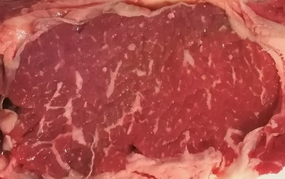
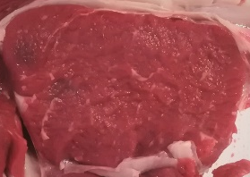
Organic dairy bull calves and 3 products
24 nurse cows + 48 Holstein bull calves
32 calves grass based ration
16 best young steers, slaughtered, 15-16 month
16 young steers grass based ration
16 best calves slaughtered, 8 month
Organic ”Danish Veal” product
Organic young steers
16 steers, slaughtered 25-26 month
High IMF, Organic beef product
From: Margrethe Therkildsen, Aarhus University
Notes:
Forsøgsdesign
Alle dyr er slagtet på Danish Crown Aalborg, og samme dag er der udvalgt 10-14 Dansk kalv Holsteing tyrekalve fra én besætning som reference dyr. Prøveudtagning og videre håndtering af kødet er sket fuldstændigt ens for de to dyre materialer

Slide 4
Slagtekvalitet – Dansk kalv versus Grobeat
From: Margrethe Therkildsen, Aarhus University
 | Reference Dansk Kalv | GrOBEat - kalv | GrOBEat - Ungkvæg | GrOBEat - Oksekød | SEM | Signifikans
Antal dyr | 36 | 16 | 16 | 16
Slagtealder, mdr | 9,5 | 8 | 16 | 26
Slagtevægt, Kg | 212 | 180 | 259 | 358 | 4,1 | ***
Form, EUROP | 3,45 | 3,21 | 2,70 | 3,5 | 0,13 | ***
Fedme, EUROP | 2,28 | 2,56 | 2,25 | 3,37 | 0.12 | ***
Farve, EUROP | 3,00 | 3,00 | 3,06 | 3,00 | 0,03 | NS

Slide 5
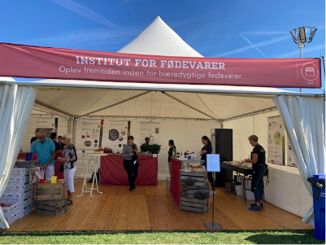
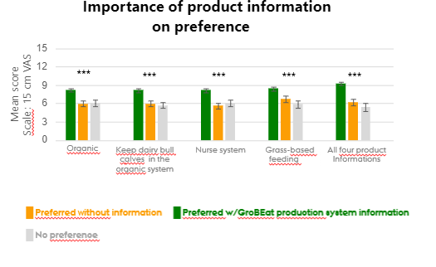
GrOBEat
Food festival (224 personer):
Data from: Barbara Vad Andersen, Aarhus University

Slide 6
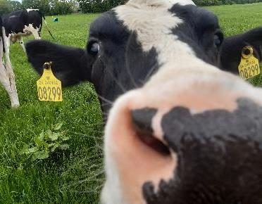
GrOBEat
Margrethe Therkildsen, Institut for Fødevarer, Aarhus Universitet (Projektledelse)
Mogens Vestergaard, AniVet, Troels Kristensen, Agro, Lisbeth Mogensen, Agro, Barbara Vad Andersen, Food, Nora Chaaban, Food, Aarhus Universitet
Kirstine Flintholm Jørgensen og Camilla Kramer, Center for Frilandsdyr
Iben Alber Christiansen, Innovationscenter for Økologisk Landbrug
Støttet af:

